Slide 1
Engineering Chemistry
Unit V
Spectroscopic Techniques
Topic: Single Beam Spectrophotometer
Department of Applied Science
Pune Institute of Computer Technology, Pune

Slide 2
Single Beam Spectrophotometer
Spectrophotometer is a device used to analyse the matter, based on its interaction with electromagnetic radiation.
In UV-Visible spectroscopy there are two types of spectrophotometer one is called as a single beam spectrophotometer and other double beam spectrophotometer.
Here single beam spectrophotometer will be discussed.

Slide 3
Single Beam Spectrophotometer
Principle:
The spectrophotometer is based on Beer’s law and theory of electronic transition.
Beer’s law states that absorption of an electromagnetic radiation is directly proportional to concentration of analyte in a homogeneous solution, when a beam of monochromatic light passes through it.
Theory of electronic transition states that when analyte absorbs the electromagnetic radiation, electrons from lower energy orbital (bonding ) gets exited to higher energy orbital (antibonding).

Slide 4
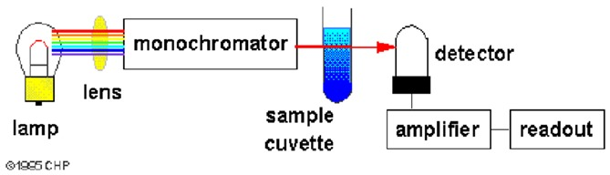
Single Beam Spectrophotometer
Source of Image: https://www.ncbi.nlm.nih.gov/books/NBK92014/figure/assayequip.F15/

Slide 5
Single Beam Spectrophotometer
Components:
Source of light
Monochromator
Sample Cell or Sample holder
Detector
Amplifier
Recorder

Slide 6
Single Beam Spectrophotometer
Source of Light:
Here the source of light should be a polychromatic and continuous source. Which emits UV-Visible light of broad range (200-800 nm), with sufficient intensity. Here Incandescent filament lamps like tungsten filament lamp or tungsten-halogen lamp are used. This lamp emit visible light of range 330 nm to 780 nm .
For UV light hydrogen or deuterium discharge lamp is used, emitting light of wavelength range 160-360 nm.

Slide 7
Single Beam Spectrophotometer
Monochromator:
It is a device which convert polychromatic light into monochromatic light ( here monochromatic light means set of waves with narrow frequency range). It consist of Lenses, Mirrors, Slits and wavelength selector.
The Slits are of two type Entrance slit and exit slit,
Entrance slit: It is place between source and wavelength selector. The entrance slit allows to enter specific portion of radiation to enter in the monochromator.
Exit slit : it is placed between wavelength selector and sample holder

Slide 8
Single Beam Spectrophotometer
Monochromator:
Wavelength Selector: The wavelength selectors are the devices which actually converts polychromatic light into monochromatic light
They are Filters, Prism or Diffraction grating
Filters: are the coloured films which makes light monochromatic. But still the monochromatic spectrum obtained is broad.
Prism: It is a transparent optical material which has ability to disperse the light, due to which light of different colours(wavelength) gets separated. It is one of the efficient wavelength selector, that separate monochromatic light of narrow range.

Slide 9
Single Beam Spectrophotometer
Monochromator:
Diffraction Grating: It is a optical device having large number of alternately placed slits and opaque areas parallel to each other. When light fall on it, polychromatic light gets dispersed and a narrow range of monochromatic wave can be obtained.
The diffraction grating are of two types.
Transmission grating: here it is formed by drawing number of parallel lines on a glass plate by diamond point. The lines made will act as opaque areas and area between two lines will acts as slit.
Reflective grating: When large number of parallel grooves are made on a reflective surface the it is called as reflective grating

Slide 10
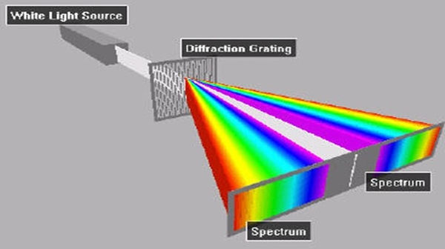
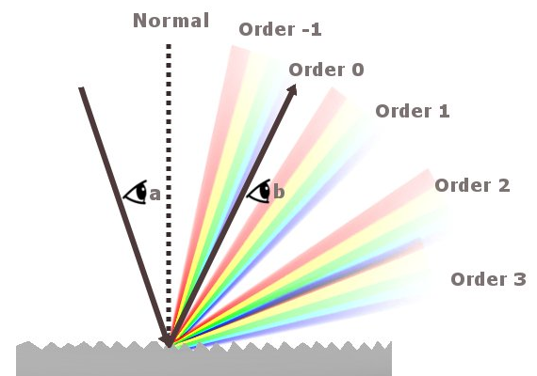
Single Beam Spectrophotometer
Transmission grating
Source: https://www.quora.com/What-is-the-function-of-diffraction-grating
Reflectivec grating
Source:
https://www.scienceabc.com/nature/what-is-diffraction-what-is-diffraction-grating.html

Slide 11
Single Beam Spectrophotometer
Sample cell or Sample holder:
The monochromatic light obtained from monochromator passes through analyte sample contained in a sample holder.
Sample holder is a rectangular or cylindrical cell in which solution of analyte is taken. For coloured solution glass and for colourless solution quartz cell is used.
It has 1 cm path length.

Slide 12
Single Beam Spectrophotometer
Detector:
In case of spectrophotometer the detector used is a device that converts light energy into electrical signal. Photovoltaic cell, phototube, photomultiplier tube can be used as a detector in spectrophotometer.
Phototube: Phototube consist of a evacuated glass tube in which a half-cylindrical cathode is placed. The inner surface of the cathode is coated with photosensitive material such as Cesium or Potassium oxide and a metal wire acts as anode.

Slide 13
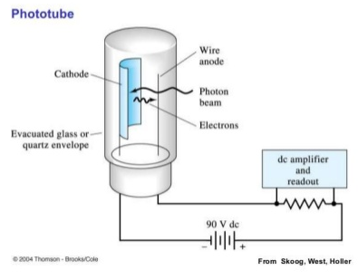
Single Beam Spectrophotometer
Detector:
The two electrodes are subjected to high voltage. When light falls on cathode it ejects an electrons, the electrons are captured by anode leading to flow of current.
The current is measured and amplified and converted into spectral data.

Slide 14
Single Beam Spectrophotometer
Amplifier:
The amplifier amplifies the electrical signal given by detector and supply to readout device
Read out Device:
It converts the electrical signal into spectroscopic data i.e. Wavelength and corresponding absorption or transmission.

Slide 15
Assignment
Give principle, construction of Single beam spectrophotometer.
Explain any one detector used in Single beam spectrophotometer.
What is monochromator? Explain the components of monochromator.

